Slide 1

Note: The data and information in this document is reflective of a hypothetical situation and client. This document is to be used for KPMG Virtual Internship purposes only.
Sprocket Central Pty Ltd
Data analytics approach
[Division Name] - [Engagement Manager], [Senior Consultant], [Junior Consultant]

Slide 2
Note: The data and information in this document is reflective of a hypothetical situation and client. This document is to be used for KPMG Virtual Internship purposes only.
Agenda
Introduction
Data Exploration
Model Development
Interpretation

Slide 3
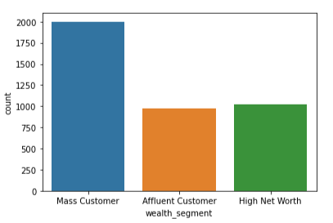
Note: The data and information in this document is reflective of a hypothetical situation and client. This document is to be used for KPMG Virtual Internship purposes only.
Introduction
Mass customers bring in as much deals as Affluent and High net worth customers combined
This is an interesting insight as it can help focus marketing on this market segment for optimal returns.
The client can also grow with them and churn is nit as risky as it is inly a small percentage of the overall likely.
Place any supporting images, graphs, data or extra text here.

Slide 4
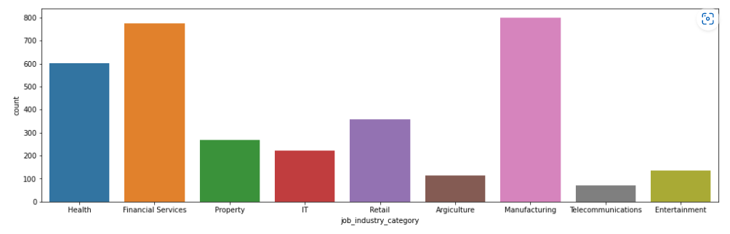
Note: The data and information in this document is reflective of a hypothetical situation and client. This document is to be used for KPMG Virtual Internship purposes only.
Data Exploration
Most customers are from the manufacturing, financial services, and health sectors followed by retail.
The top four industry of customers combined brings in up to or more sales than the others combined together.
Place any supporting images, gaphs, data or extra text here.

Slide 5
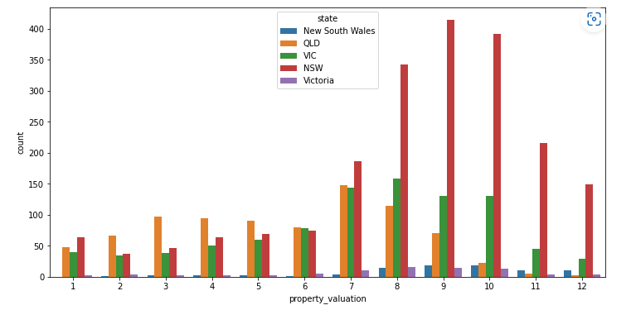
Note: The data and information in this document is reflective of a hypothetical situation and client. This document is to be used for KPMG Virtual Internship purposes only.
Data Exploration
Most customers are own homes with very high values. The range of 7 to 12 contains most of the customers especially concentrated in NSW followed by VIC.
Apparently, lower valued home owners that buy from the client are from QLD. Attention should be given to high valued home owners in NSW and VIC
Place any supporting images, gaphs, data or extra text here.

Slide 6
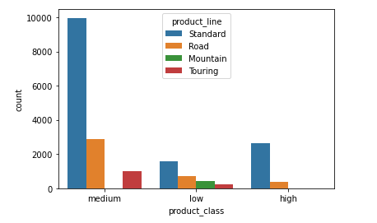
Note: The data and information in this document is reflective of a hypothetical situation and client. This document is to be used for KPMG Virtual Internship purposes only.
Data Exploration
Most purchases are medium product classes especially the standard product line. Mountain product line is least popular product line without any recorded sales for the medium product class at all.
It is almost glaring that people don’t like the low end product class and apparently, the preferred product class for most customers is the medium especially the standard product line
Place any supporting images, gaphs, data or extra text here.

Slide 7
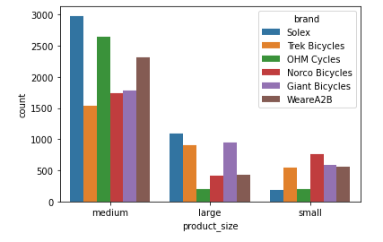
Note: The data and information in this document is reflective of a hypothetical situation and client. This document is to be used for KPMG Virtual Internship purposes only.
Data Exploration
Most customers prefer products in the product size category, medium. It seems the brand does not make any significant difference in the choice of product size as well.
The large portion of customers prefer medium sized products overwhelmingly. It appears customers in the target market prefer medium sized products just as much as they like medium class product class and standard ones.
Place any supporting images, gaphs, data or extra text here.

Slide 8
Note: The data and information in this document is reflective of a hypothetical situation and client. This document is to be used for KPMG Virtual Internship purposes only.
Model Development
Use random forest classification to maximize accuracy
The process is as below:
Create a new data frame containing relevant columns (customer_demographic - past_3_years_bike_related_purchases, job_industry_category, wealth_segment; customer_address -state, property_valuation; transactions - product_class, product_size)
Get the dummies for the categorical data
Do the split, fit and run the classifier.

Slide 9
Note: The data and information in this document is reflective of a hypothetical situation and client. This document is to be used for KPMG Virtual Internship purposes only.
Interpretation
People who are predicted to potentially buy more from the new customers list using the model
Place any information about this point here.
Place any supporting images, graphs, data or extra text here.

